Slide 1
Istation for Parents
Created by Sarah Mailhot, Swift Creek Elementary

Slide 2
What is Istation?
Formative assessment tool to determine a child’s reading ability
Includes ISIP (Istation Indicator of Progress) assessments
ISIP Early Reading Assessments (previously foundational skills of DIBELS)
ISIP Oral Reading Fluency (formerly TRC)
At home access (iPractice) and parent portal

Slide 3
What is assessed?
Grade
Subtest
Kindergarten Listening Comprehension
Phonemic Awareness
Letter Knowledge
Vocabulary
1st Grade Phonemic Awareness
Letter Knowledge
Vocabulary
Alphabetic Decoding
Comprehension
Spelling
Connected Text Fluency*
(Maze/Cloze Passages)
**Text fluency subtest not included in overall ability score
ISIP Early Reading

Slide 4
What is assessed?
Grade
Subtest
Vocabulary Comprehension Spelling Connected Text Fluency
(Maze/Cloze Passage)
ISIP Early Reading
2nd & 3rd Grade

Slide 5
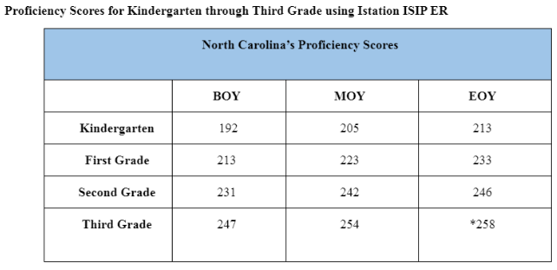
Proficiency Scores
Proficiency scores by grade level

Slide 6
Read to Achieve Law
“Read to Achieve requires LEAs to conduct periodic reading diagnostic assessments to measure student literacy skills. Neither federal law, the Read to Achieve legislation, or State Board of Education policy allows parents to “opt-out” of statewide reading assessments. Parents who have concerns with the technology used in the Istation assessment may request an approved alternative assessment from the LEA.”

Slide 7
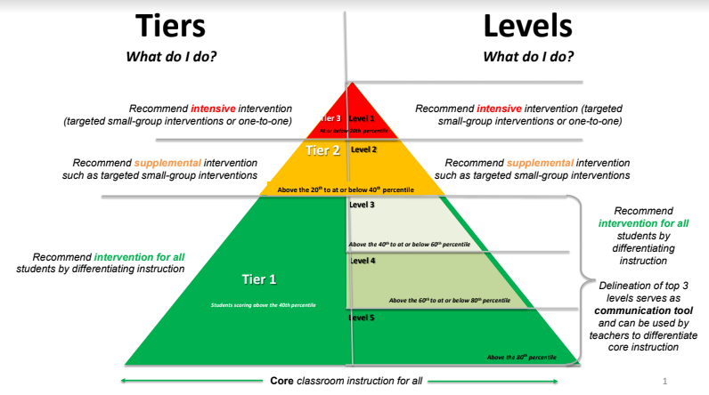
A child must have a proficiency score in the 70th percentile or greater

Slide 8
Parent Portal

Slide 9
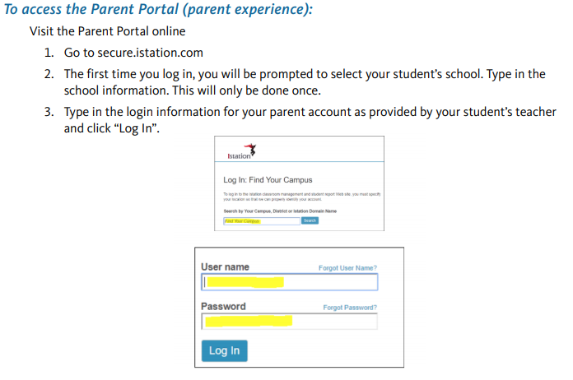
Notes:
These are directions on accessing the parent portal on your phone

Slide 10
Go to:
secure.istation.com

Slide 11
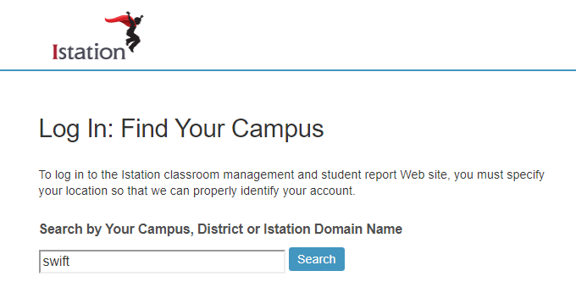
Make sure you find Swift Creek in Wake County!

Slide 12
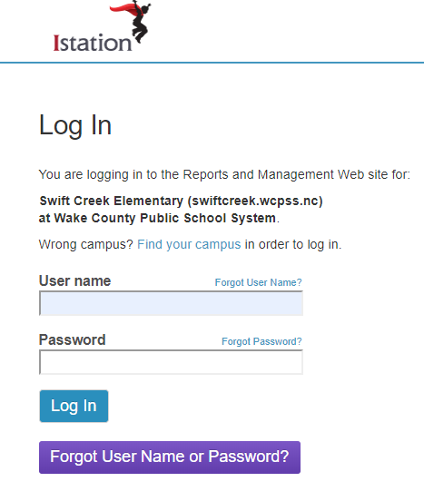
Use the username found in your parent report letter to log in

Slide 13
Use the username found in your parent report letter to log in

Slide 14
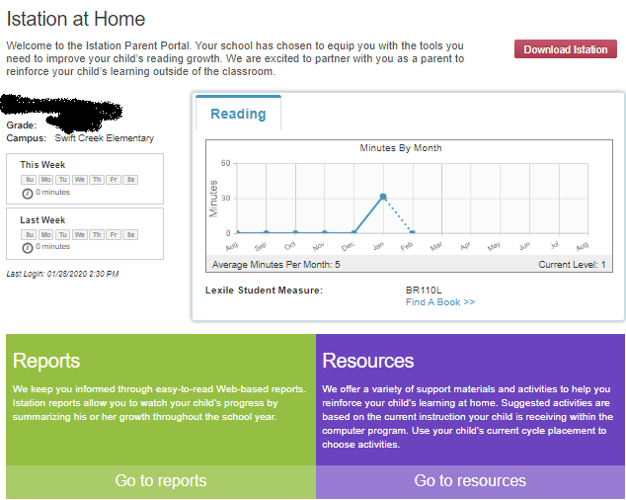
This is where you can find the Student Summary report in color

Slide 15
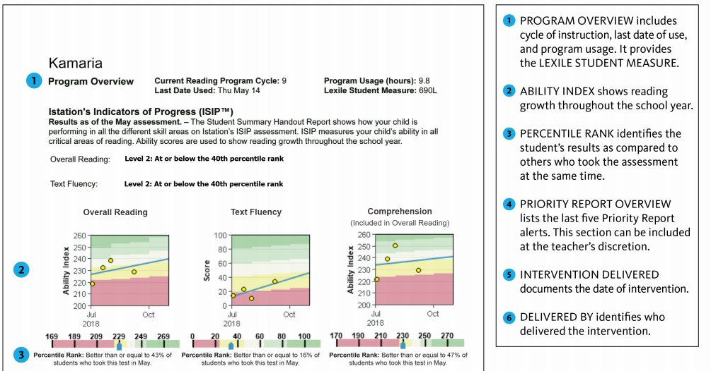
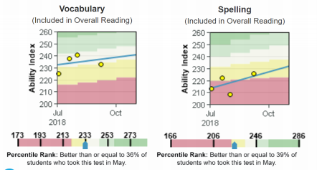
Student Summary Reports

Slide 16
Notes:
Follow these directions if you want to download Ipractice on your home computer or tablet

Slide 17
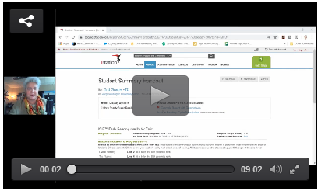
Student Summary Reports
Notes:
Notes to hit in reports:
Percentile ranks are nationally normed
Subtests shown may be different
Overall score includes spelling, comprehension, text fluency stands on its own
The dots are the number of times a student has taken an assessment (updates in real time)
THe line is the trend line to show growth

Slide 18
Questions?
This presentation will be posted on our school’s website

Slide 19
Breakout Session #2: 7:15-7:45
Zones of Regulation: Room 214
Intervention: Room 211
Special Education: Room 212
English as a Second Language: Room 210
Using Music for Reading Fluency: Room 207

